Slide 1



MATURI VENKATA SUBBA RAO ENGINEERING COLLEGE
(An Autonomous Institution)
Project Title: IOT BASED-SMART DUSTBIN
Guide Name: M.ANUPAMA
Team Members: SRIKANYA-245121733308 GAYATHRI-245121733309 SATVIKA-245121733313

Slide 2
ABSTRACT
IOT BASED-SMART DUSTBIN helps to create a cleaner, safer, more hygienic
environment and enhanced operational efficiency while reducing
management costs, resources, and road-side emissions. The Smart Bin is ideal for busy locations such as campuses, theme parks .
COMPONENTS :ARDUINO-ide, Servo Motor, Power supply ,connecting wires, dustbin . These components help in opening the lid, on detection of any object and also sending the notification in the form of LED.
-Smart Dustbin works on the principle of object detection using an ultrasonic sensor.

Slide 3



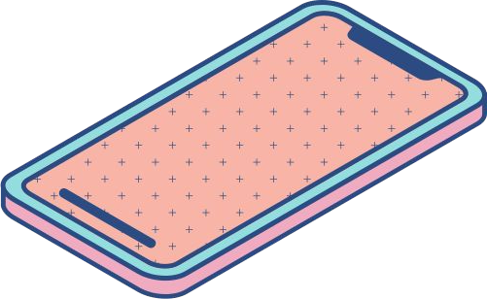
Application Areas
--Smart Bins help to create a cleaner, safer, more hygienic environment and enhanced efficiency while reducing management costs, resources. --A SMARTER BIN, FOR A SMARTER CITY :Managing our waste in a smarter manner is hugely important to the quality of our daily lives, and a pioneer of innovative smart city solutions, is contributing to improving inefficient waste management with Smart Bins. --MORE INNOVATIONS THAT ARE MAKING OUR LIVES BETTER The smarter management of waste is just one area that Guardforce is working in to make our lives, better, safer and more convenient.

Slide 4

Tools--Technology--Components Used

Slide 5
TOOLS:
Dustbin, ARDUINO-IDE, Servo Motor, Ultrasonic Sensor, Connecting wires.
1
2
TOOLS FUNCTIONING:
-- Ultrasonic sensor to detect the human sense
--Servo Motor helps in opening the lid of the dustbin.
--ARDUINO developing board to do all the processing.
--Software for simulation is ARDUINO-IDE
3

Slide 6
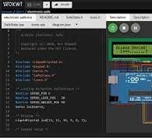
TECHNOLOGY USED AND FEATURES-- WOKWI—SIMULATOR
WOKWI IA AN ONLINE ELECTRONICS SIMULATOR.WE CAN USE IT TO SIMULATE BOARDS LIKE: ARDUINO,ESP32,AND ARDUINO UNO.
~We can simulate projects which can be connected to internet via HTTP,NTP and other protocols.
~Simulator can work on microcontroller projects from the browser, no hardware components required.
~Through this built-in visual logic analyser we can capture the digital signals in simulation.
~Multiple boards , motors, sensors and many more are available in simulator
1
2
3

Slide 7
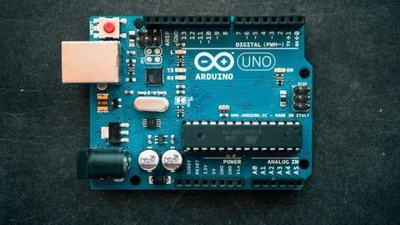
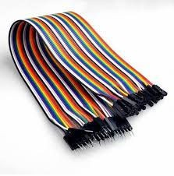
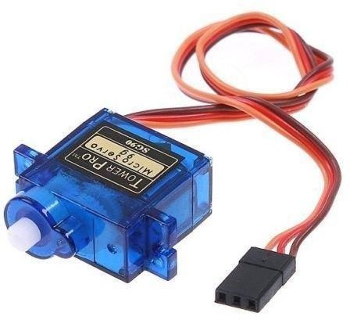
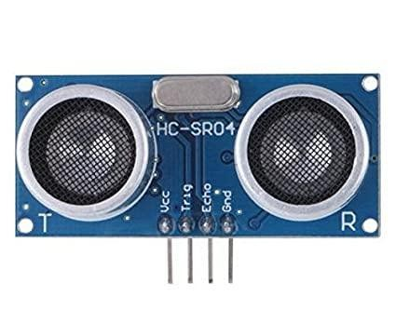
TECHNICAL COMPONENTS :
1
ARDUINO
JUMPER WIRES
2
SERVO MOTOR
3
ULTRASONICSENSOR

Slide 8

DEMONSTRATING OF CONNECTIONS

Slide 9
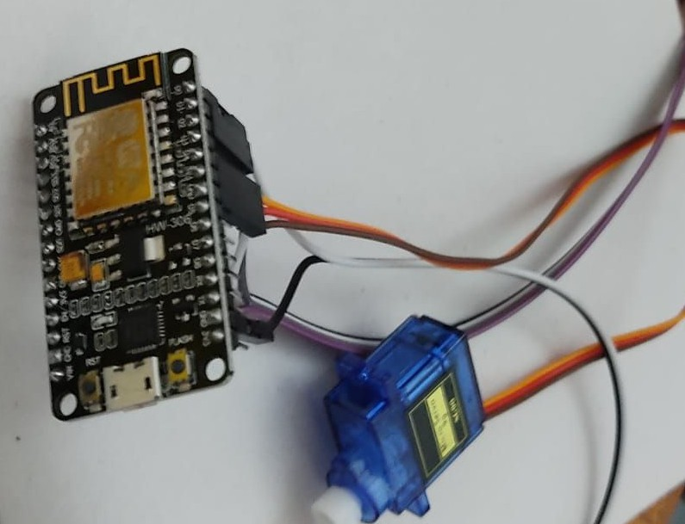
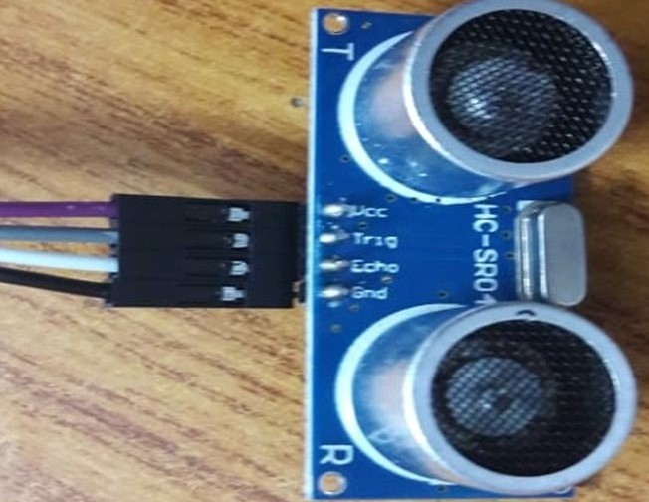
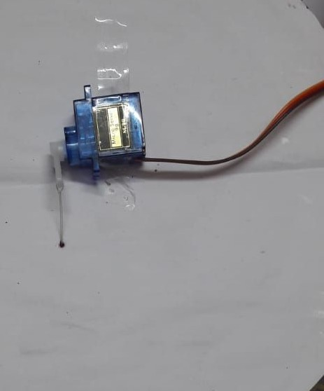
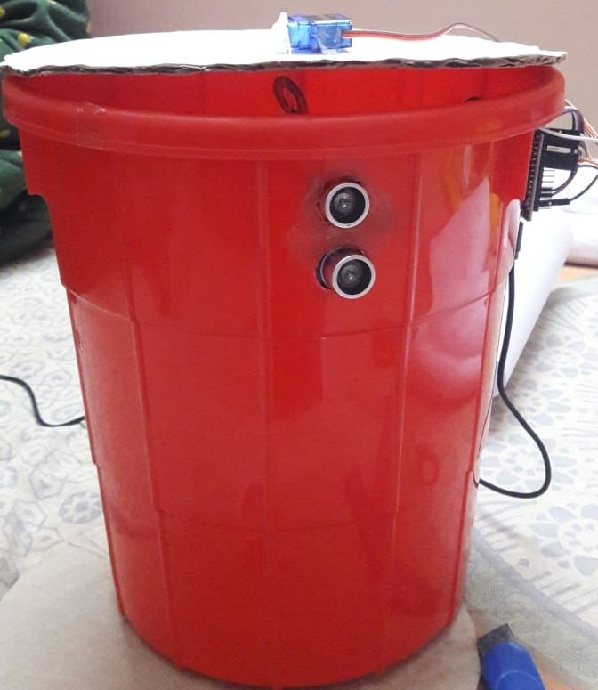
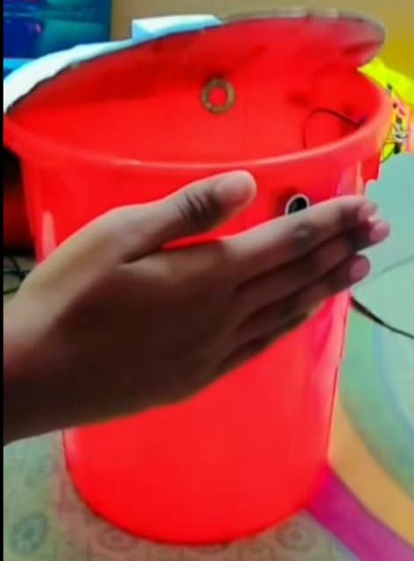
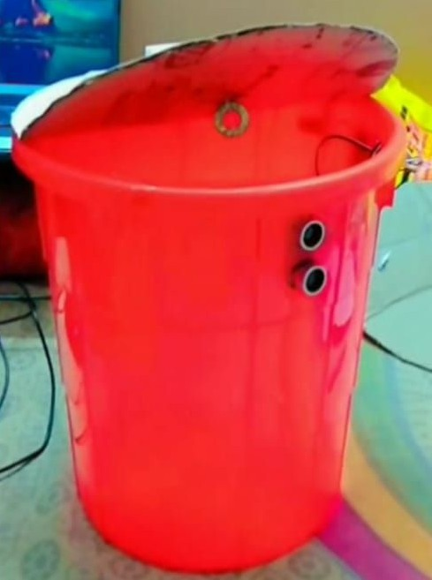
DEMONSTRATING PICTURES--
IMPLEMENTATION [ ARDUINO,SERVO MOTOR,ULTRASONIC SENSOR]--
4
5
WORKING MODEL –
6

Slide 10
Salient Features of SMART DUSTBIN

Slide 11
~~Automatic sensor based operation with zero manual intervention
~~Hygienic disposal with automatic and touch-less waste disposal
4
5
~~Smart indicators on the front display panel
~~Low power consumption
~~Designed to fit in small spaces and add to the aesthetics of your premises
~~Paper waste, plastic waste, food waste, and other commonly generated waste
~~ Used at Restaurants, food courts, hotels, offices, ships, trains, airports, adventure parks and other premium places.
6

Slide 12
SOFTWARE USED:
4
ARDUINO--IDE(INTERGARATED- DEVELOPMENT ENVIRONMENT)
5
The Arduino -IDE or Arduino software contains a text editor for writing code,a message area ,a text console,a toolbar with buttons for common functions and a series of menus.
It connects to the Arduino hardware to upload programs and communicate with them.
6

Slide 13
include<Servo.h>
Servo motor;
const int trigPin = D1; const int echoPin = D2;
//define sound velocity in cm/uS #def#ine SOUND_VELOCITY 0.034
long duration; float distanceCm; float distanceInch;
void setup() {
//Serial.begin(115200); // Starts the serial communication pinMode(D0, OUTPUT); pinMode(trigPin, OUTPUT); // Sets the trigPin as an Output pinMode(echoPin, INPUT); // Sets the echoPin as an Input
motor.attach(2); // D4 motor.write(0);
void loop() {
// Clears the trigPin digitalWrite(trigPin, LOW); delayMicroseconds(2);
// Sets the trigPin on HIGH state for 10
micro seconds digitalWrite(trigPin, HIGH); delayMicroseconds(10); digitalWrite(trigPin, LOW);
// Reads the echoPin, returns the sound wave travel time in microseconds duration = pulseIn(echoPin, HIGH);
// Calculate the distance distanceCm = duration * SOUND_VELOCITY/2;
// Prints the distance on the Serial Monitor
//Serial.print("Distance (cm): ");
//Serial.println(distanceCm); if(distanceCm < 30)
{digitalWrite(D0,HIGH); motor.write(190);
delay(5000); }
else {digitalWrite(D0,LOW); motor.write(0); }
}
4
5
6
}
}---

Slide 14
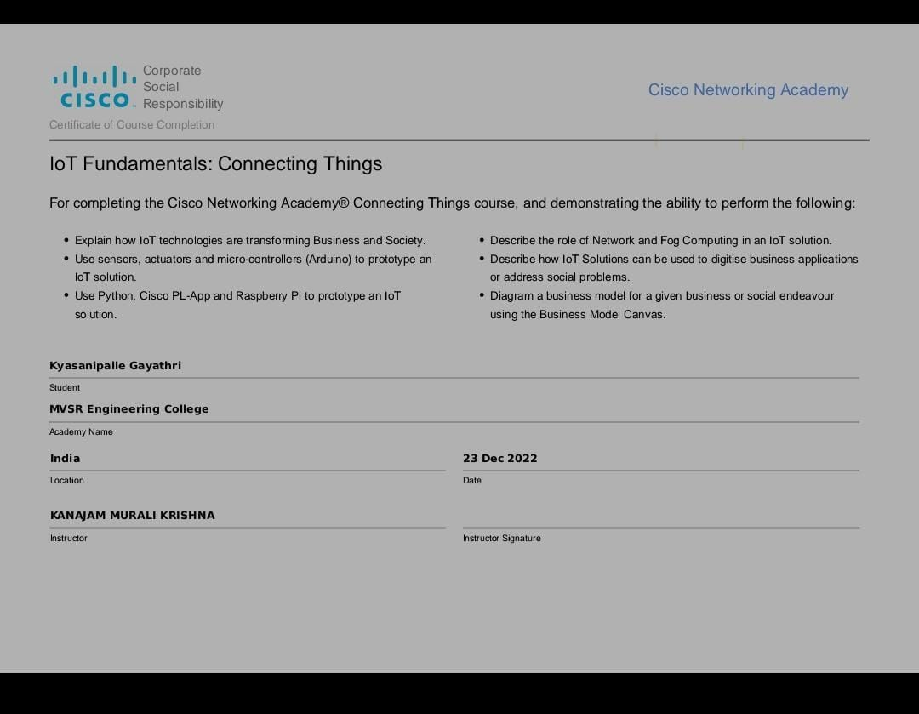
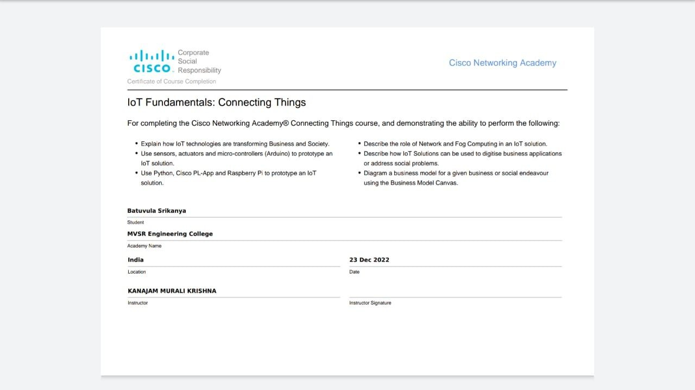
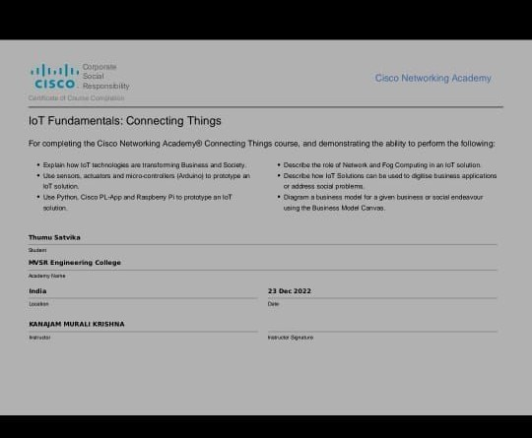
4
5
6

Slide 15


